Slide 1

LARIAT Rent-A-Car Revenue Planning
Toni Britt
1/28/2021

Slide 2
Executive Summary
Background
Figure out how increase Revenue
Calculated total Revenue, Cost, and Profit for each make and model
Identified the top and lowest profitable branches
Identified the top make and models in demand as well as the lowest
Analysis Results
Some cars have a very low profit margin
2 states are making majority of the profits
Conclusion Results
Remove the 50 lowest profitable cars and add 2 more of the top 10 selling car models
Add 2 more of the more profitable branches in the top selling states
Increase Advertising

Slide 3
Current Baseline Information
# of Cars – 4000
# of Branches – 50
Total Revenue - $52,830,207
Cost - $28,647,004.26
Profit - $24,183,202.74
Average Profit per Car - $6,0454.80
Average Profit Per Branch – $483,664.05

Slide 4
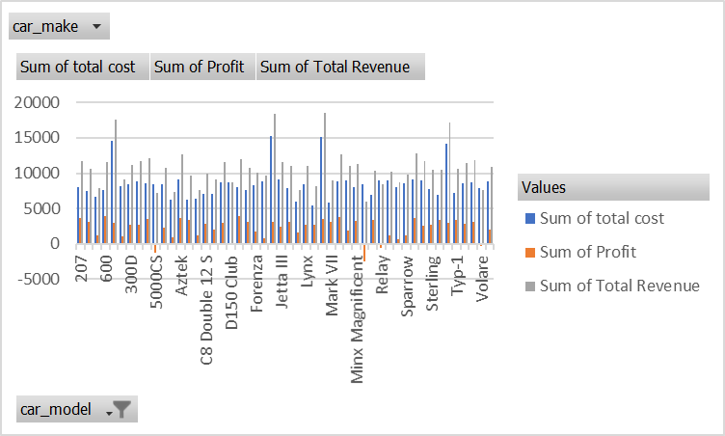
Strategy 1:
Removing the 50 lowest profiting car models
Assuming demand and costs stays the same

Slide 5
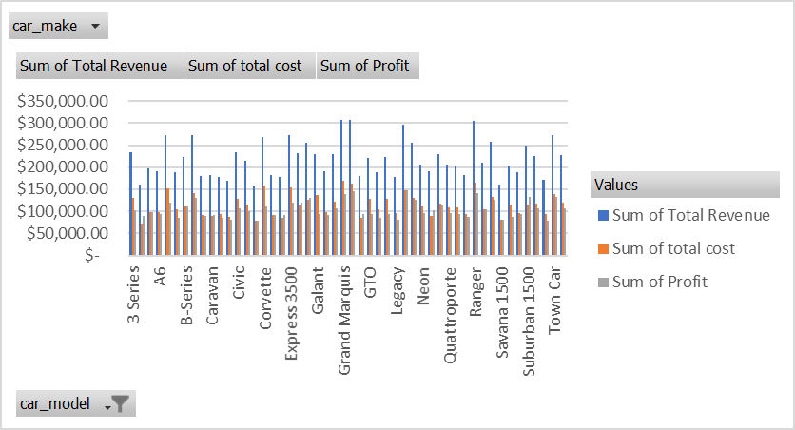
Strategy 1 Cont.
Adding 1 more of the top 50 selling car models
Assuming demand and costs stays the same

Slide 6
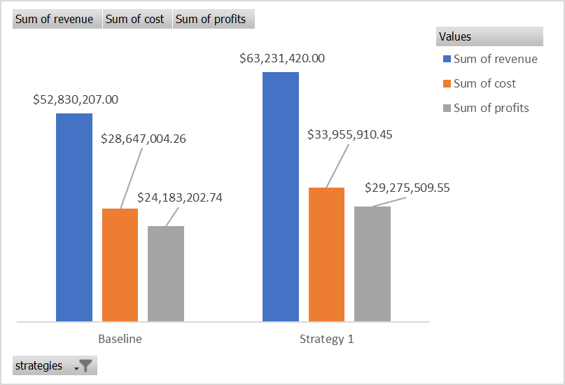
Strategy 1: Comparisons with Baseline
# of Cars – 4000
# of Branches – 50
Total Revenue - $63,231,420
Cost - $33,955,910.45
Profit - $29,275,509.55
Profit Increase – $5,092,306.81

Slide 7
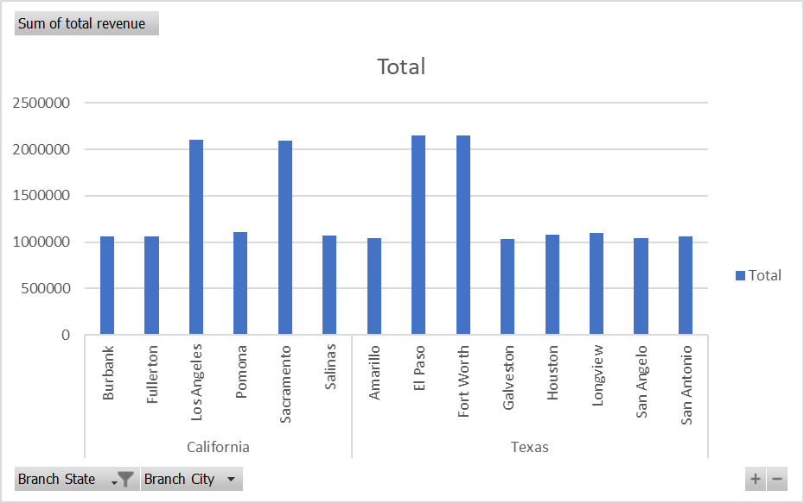
Strategy 2:
Adding 2 more branches to the top 2 selling states
Assuming demand would increase
California and Texas are the Top Grossing States
California
Total Revenue - $8,499,830
Average Branch Revenue – $1,416,638.30
Texas
Total Revenue – $10,653,531
Average Branch – $1,331,691.40

Slide 8
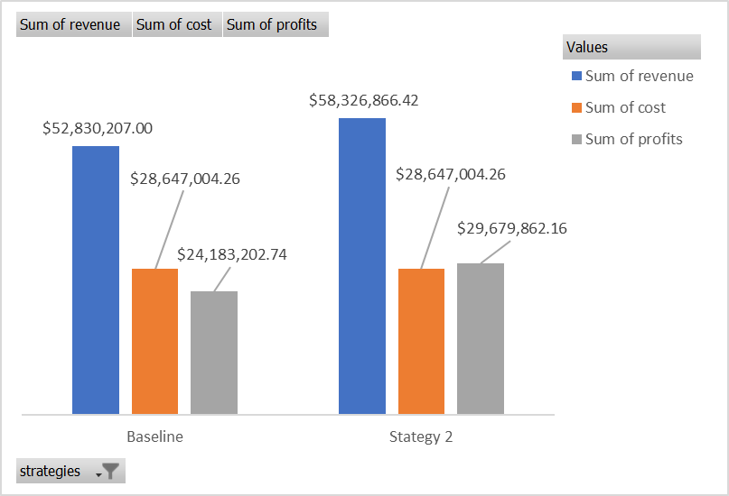
Strategy 2: Comparisons with Baseline
# of Cars – 4000
# of Branches – 54
Total Revenue - $58,326,866.42
Cost - $28,647,004.26
Profit - $29,679,862.16
Profit Increase – 5,496,659.42

Slide 9
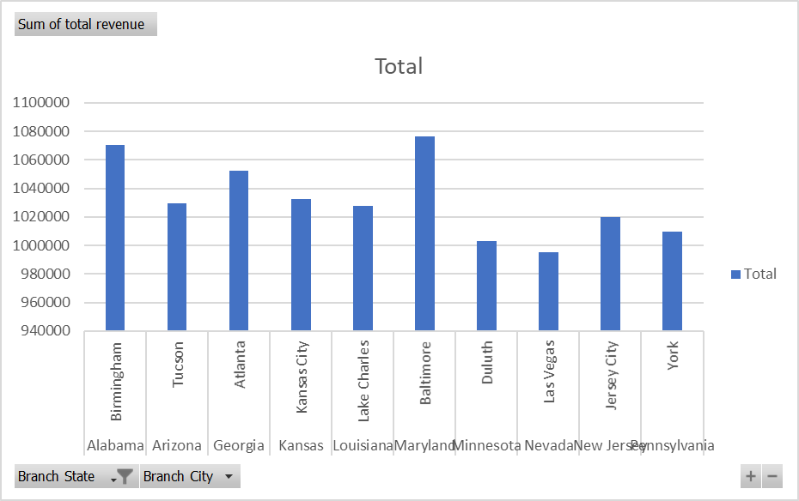
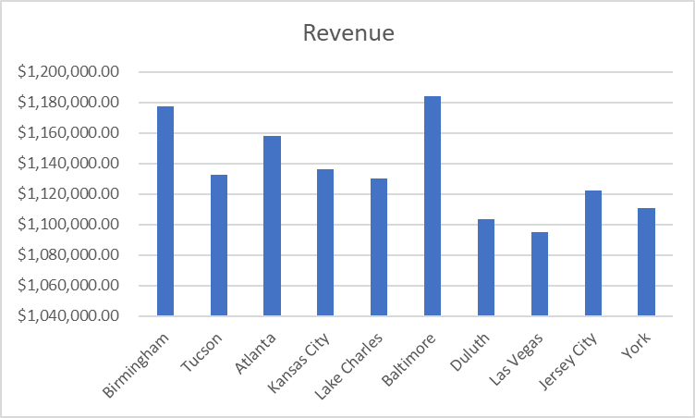
Strategy 3:
Expect a 10% increase in sales due to increased advertising in the bottom 10 branches.
Assuming cost stays the same

Slide 10
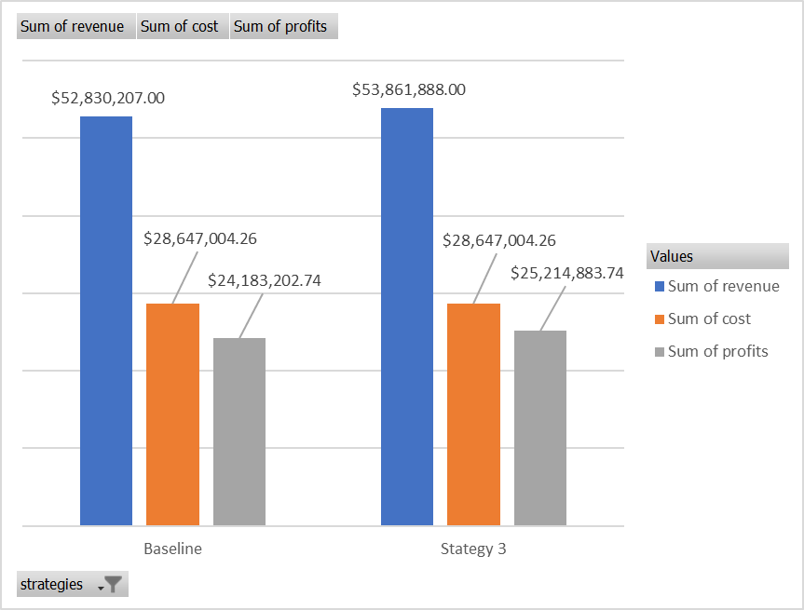
Strategy 3: Comparisons with Baseline
# of Cars – 4000
# of Branches – 50
Total Revenue - $53,861,888
Cost - $28,647,004.26
Profit - $29,466,223.44
Profit Increase – $1,031,681

Slide 11
Results
Strategy 1: Removing the 50 lowest profitable cars and adding 1 more of the top 50 selling car models assuming demand and costs stays the same.
Profit increase – $5,092,306.81
Strategy 2: Adding 2 more branches to the top 2 selling states assuming demand would double.
Profit Increase – $5,496,659.42
Strategy 3: Expect a 10% increase in sales due to increased advertisings.
Profit Increase – $1,031,681
Profit would increase if just one of these strategies are implemented.
Strategy 2 is recommended. It has a higher profitability and would allow more demand to occur within the State of Texas and California.

